Slide 1
The role of animation and touch technology in preparing students for Calculus and dynamical systems modeling.
Carlos Castillo-Garsow
Kansas State University
cwcg@k-state.edu

Slide 2
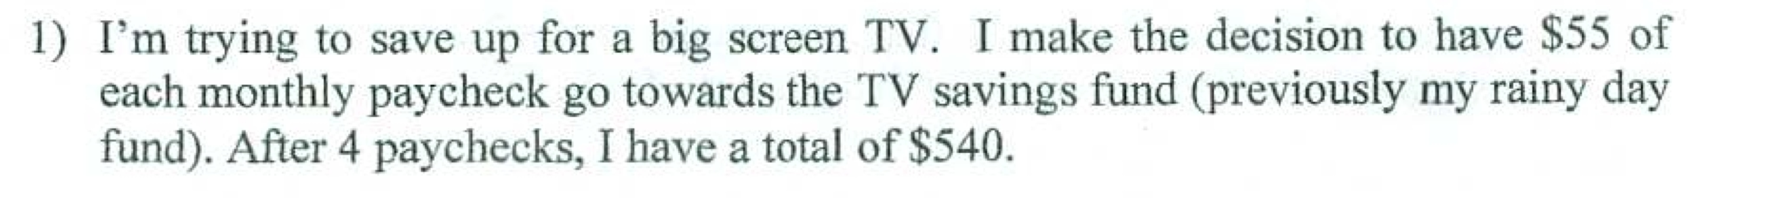
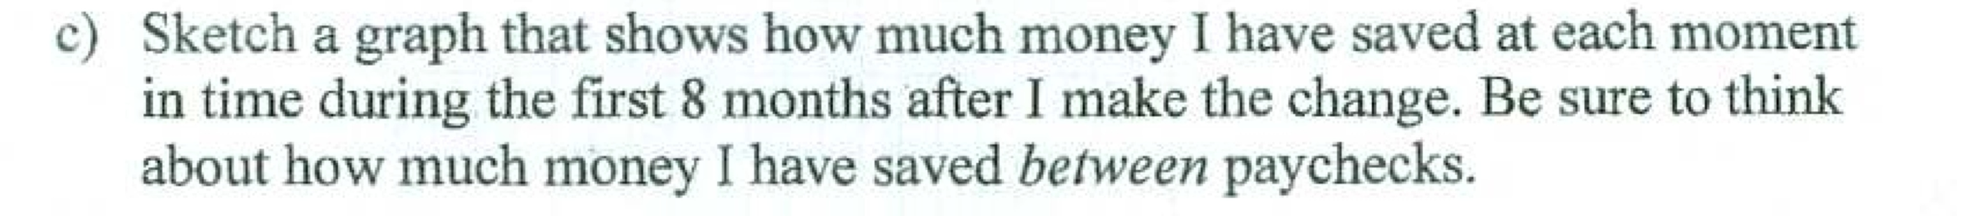
Public High School
Algebra I
Second Semester
January

Slide 3
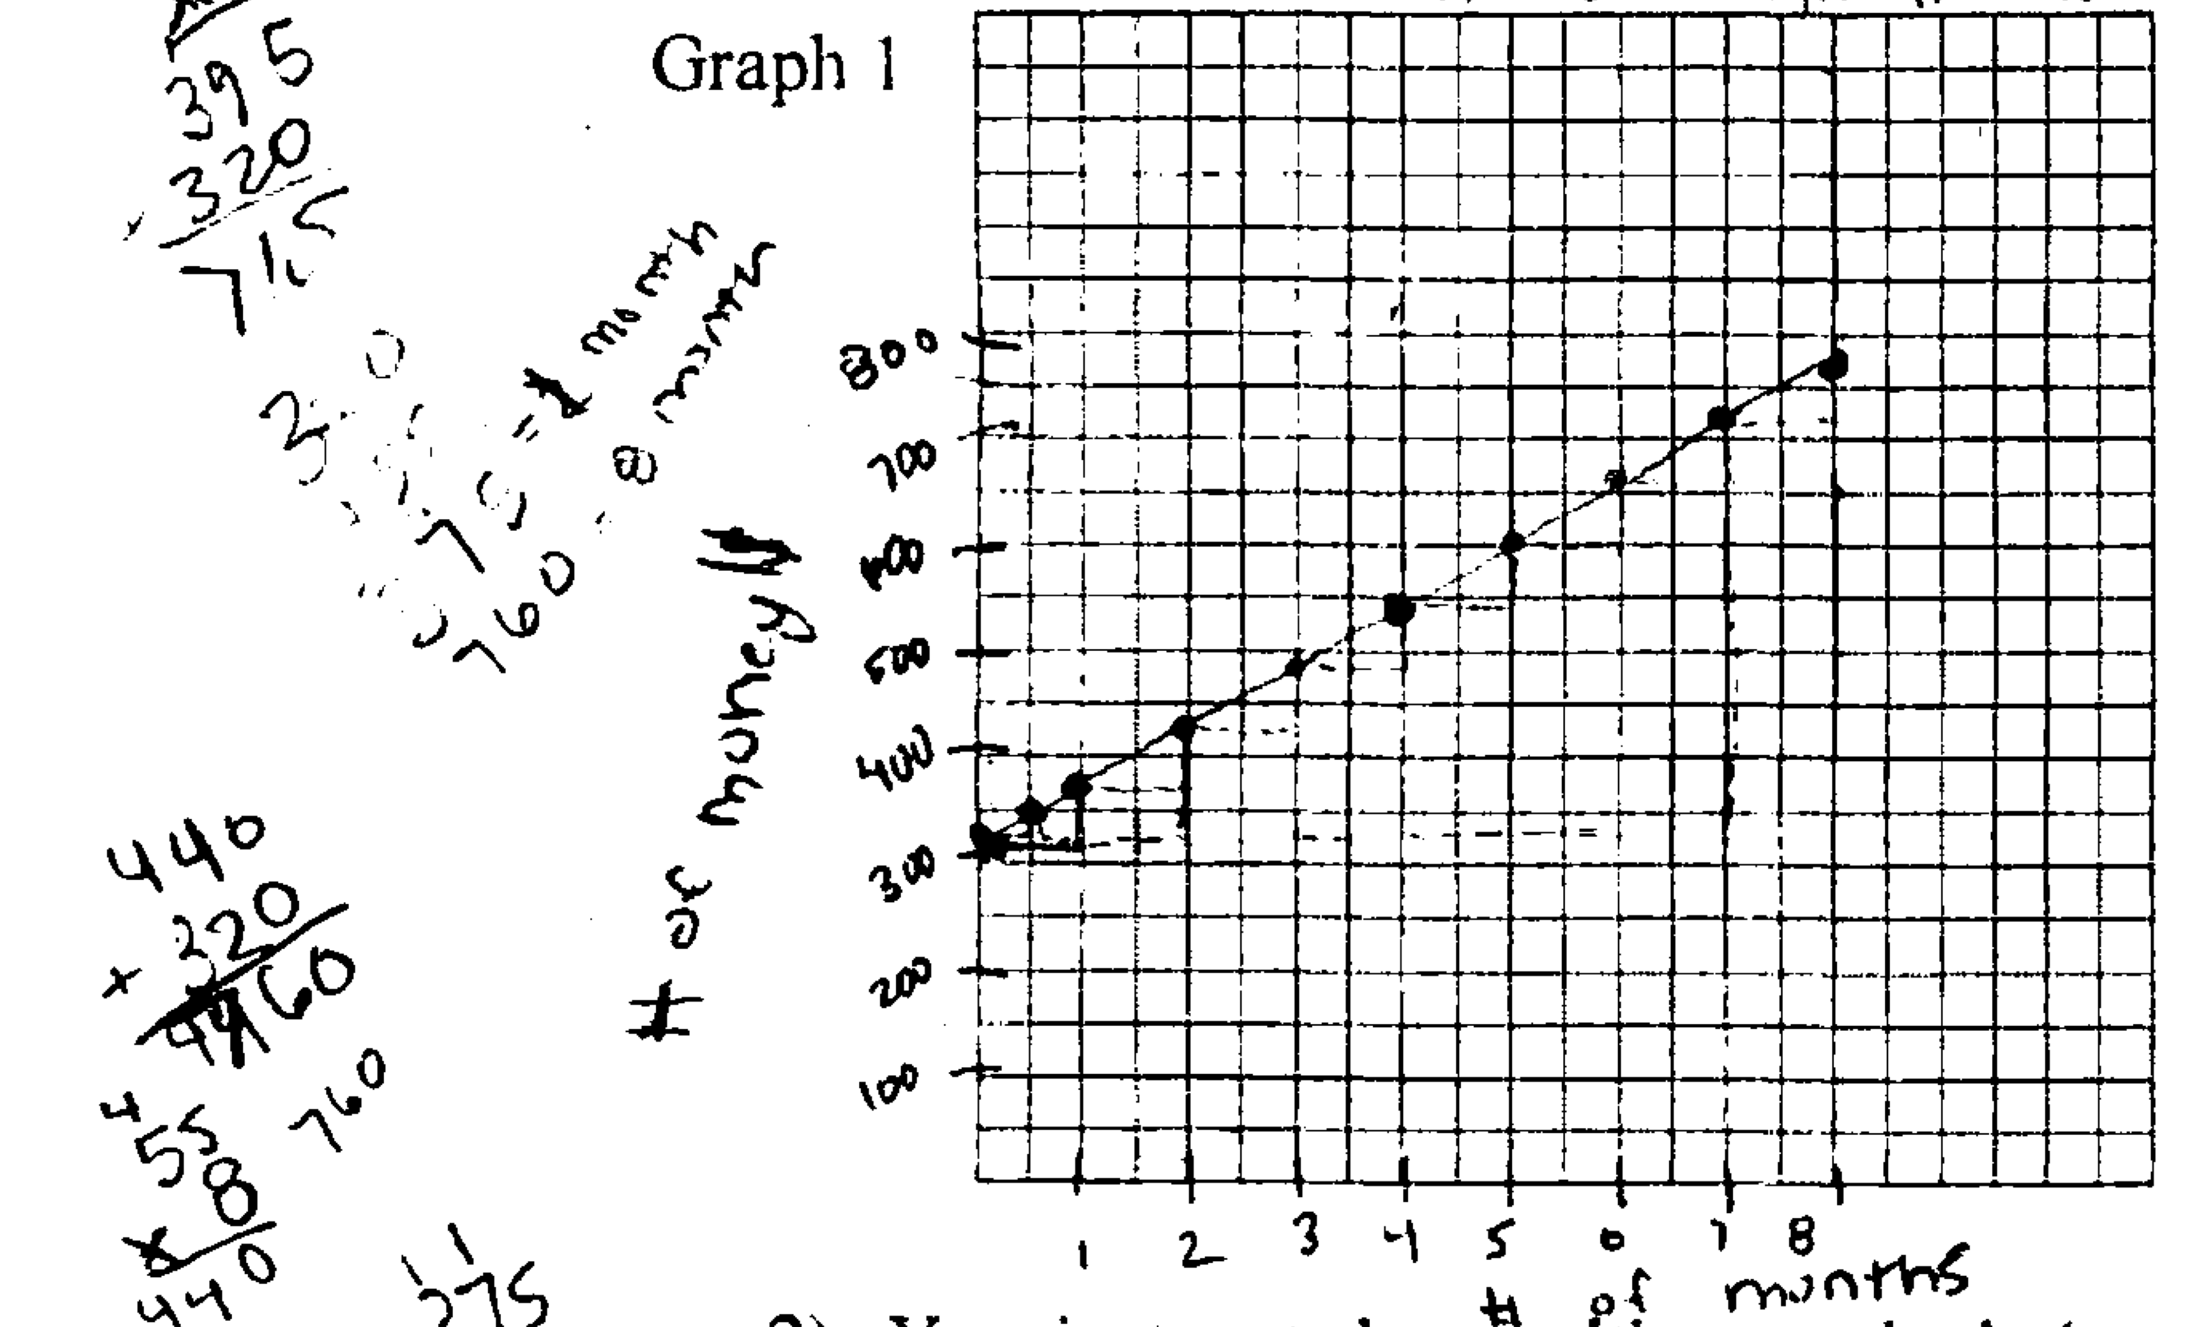

Slide 4
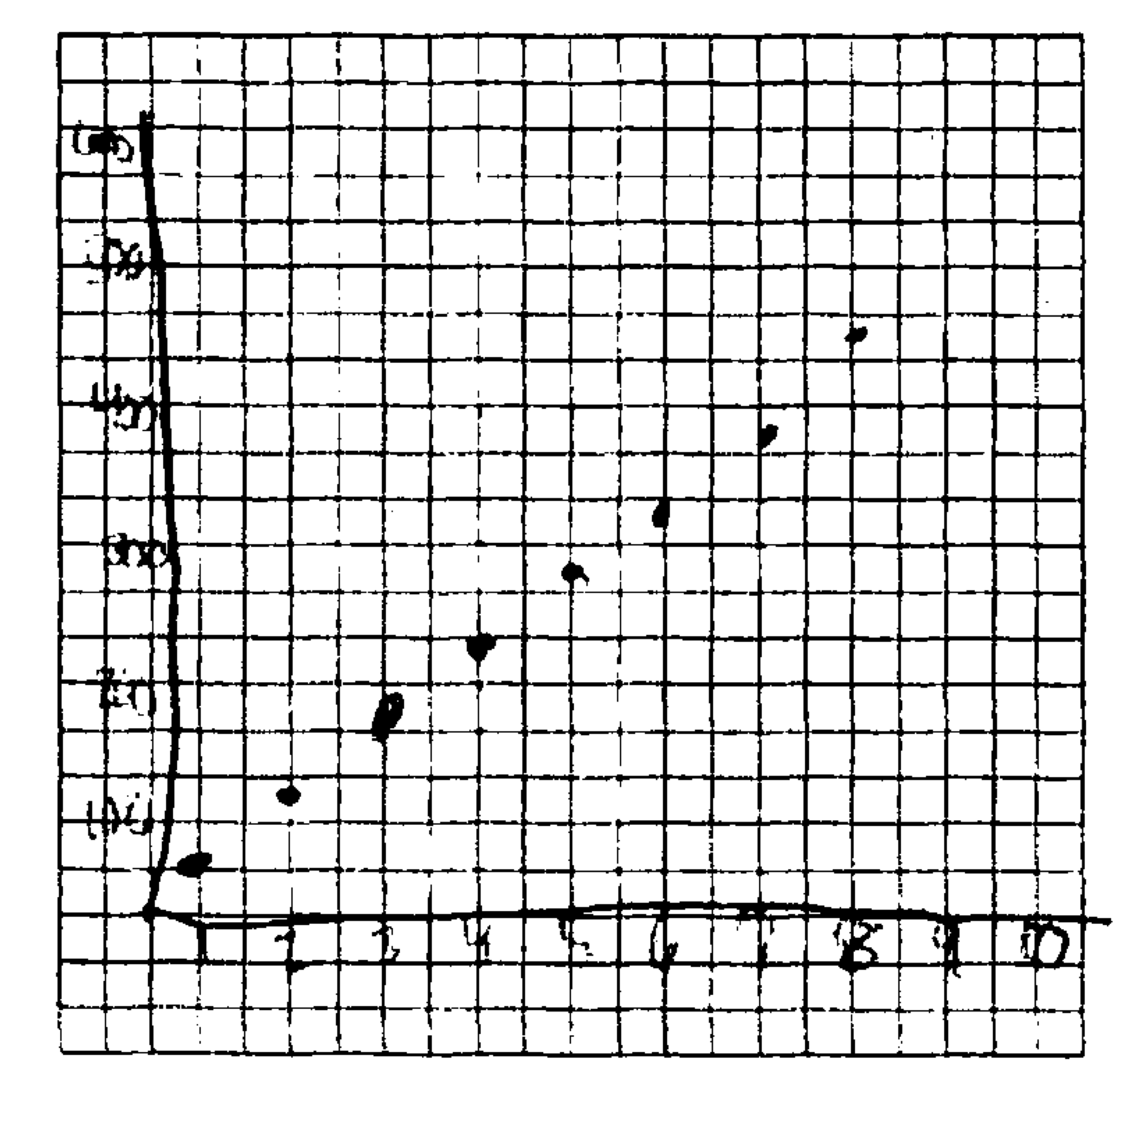

Slide 5
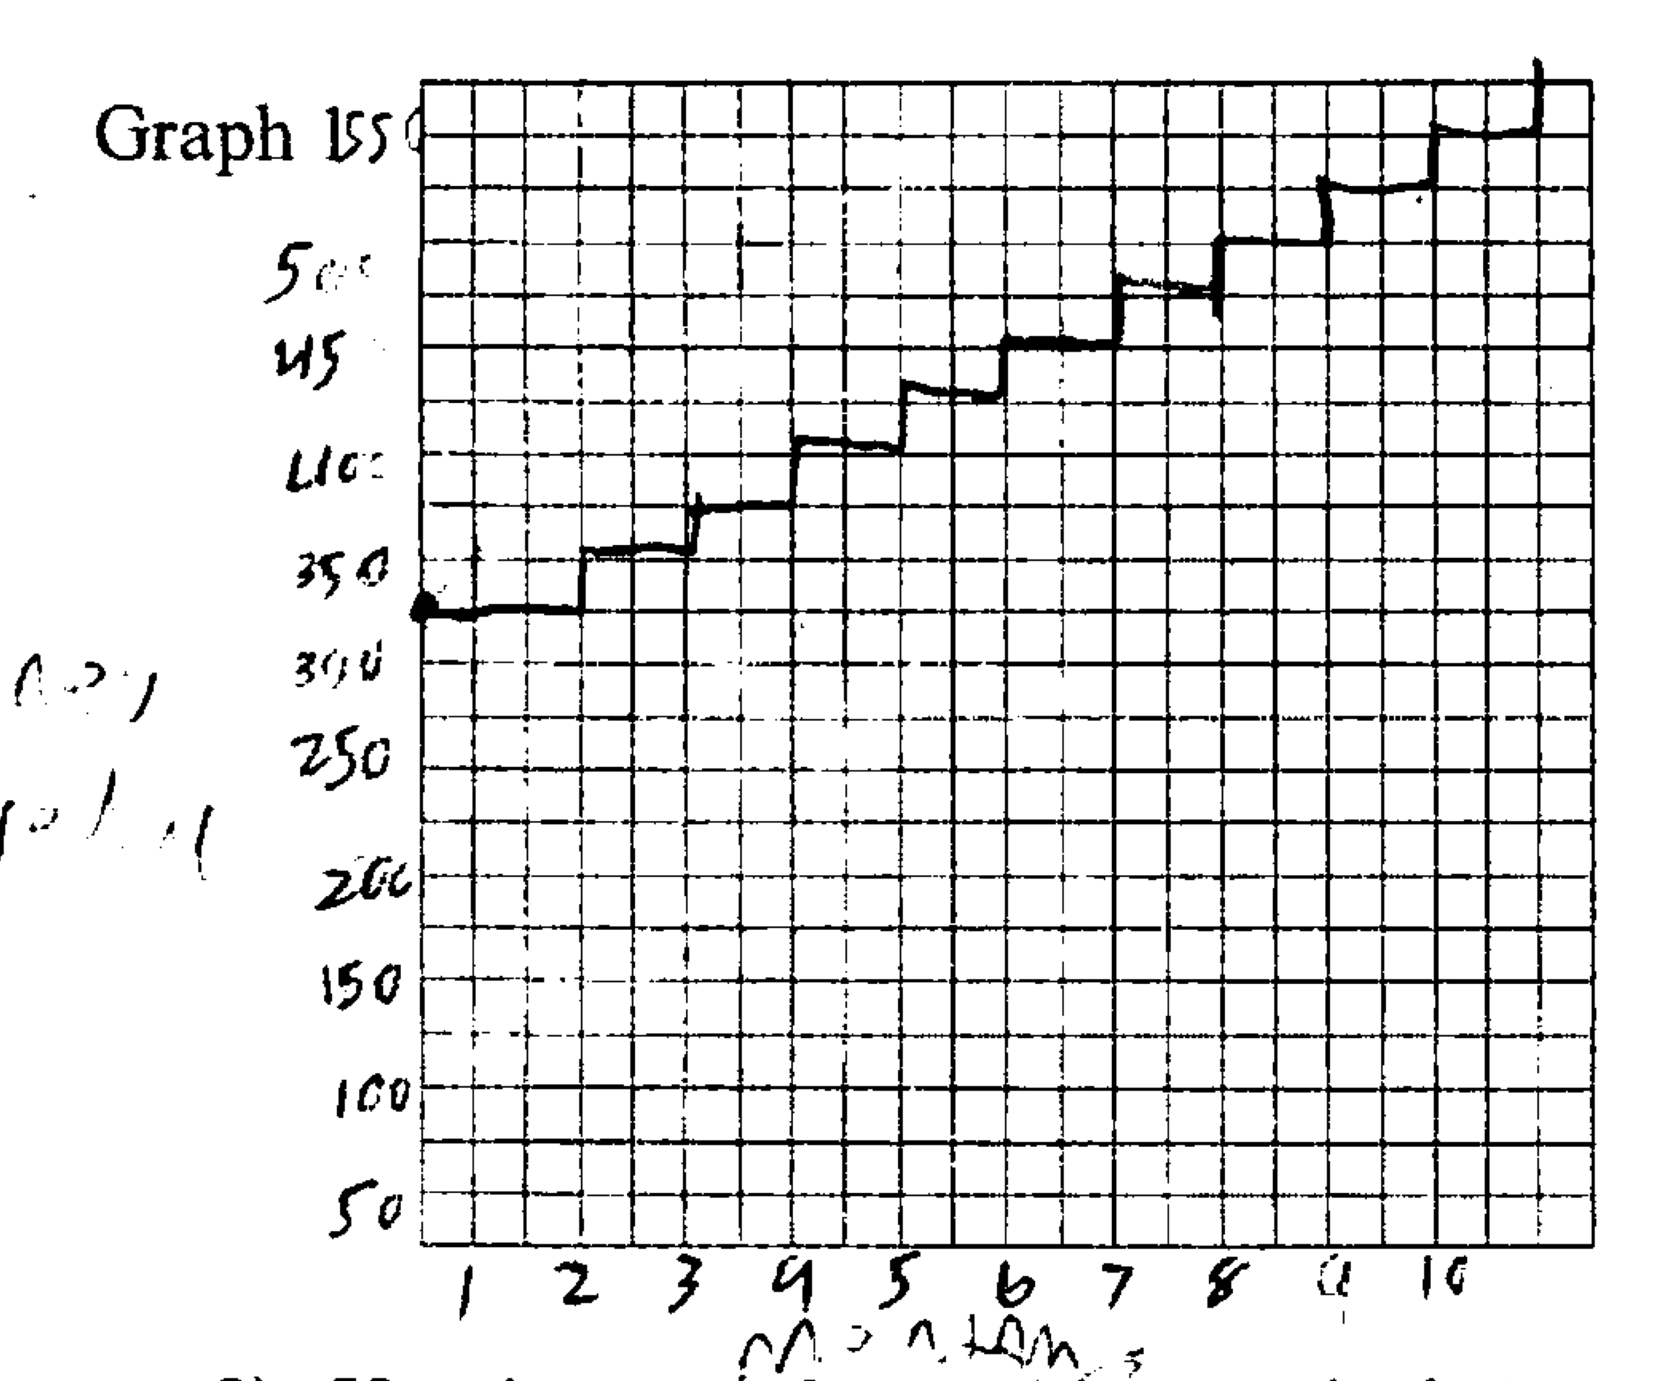

Slide 6
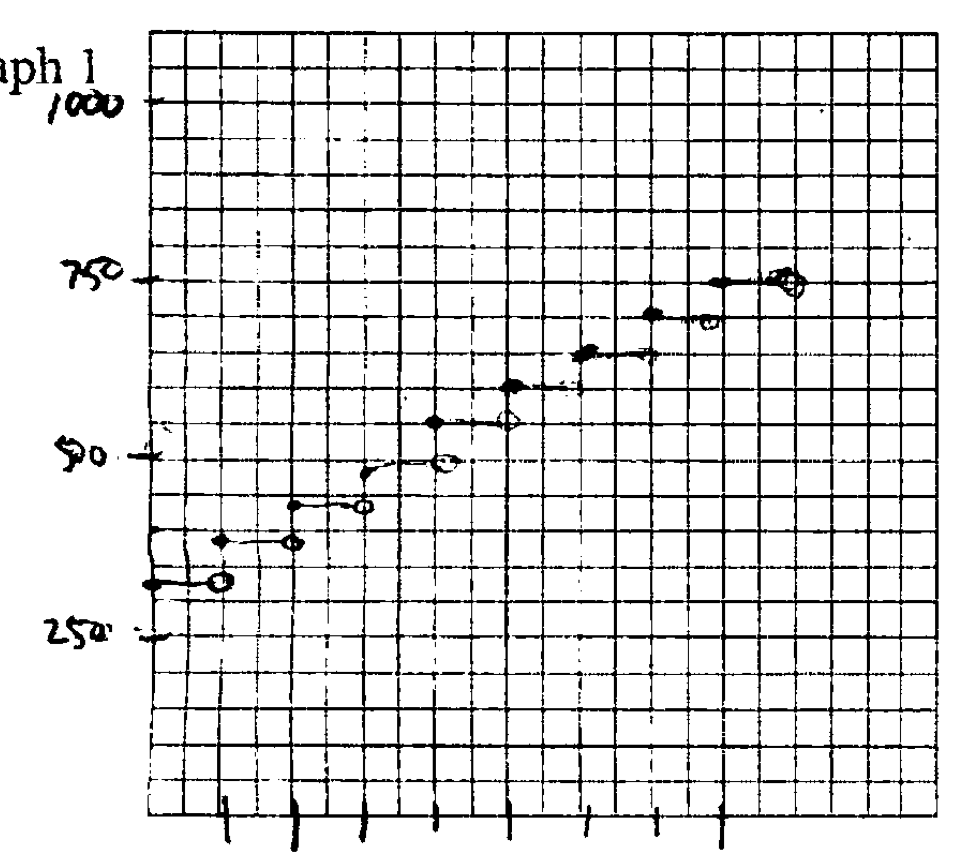

Slide 8
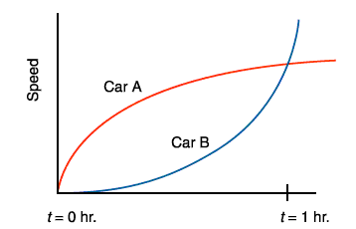
Some problems can only be solved with continuous reasoning
What are the relative positions of the cars at 1 hour?
Carlson, 1998; NCTM 2000

Slide 9
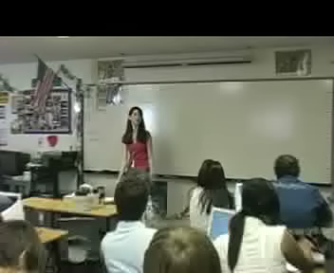
Some problems are made more accessible by continuous reasoning
Public High School
Algebra I
Second Semester
May

Slide 10
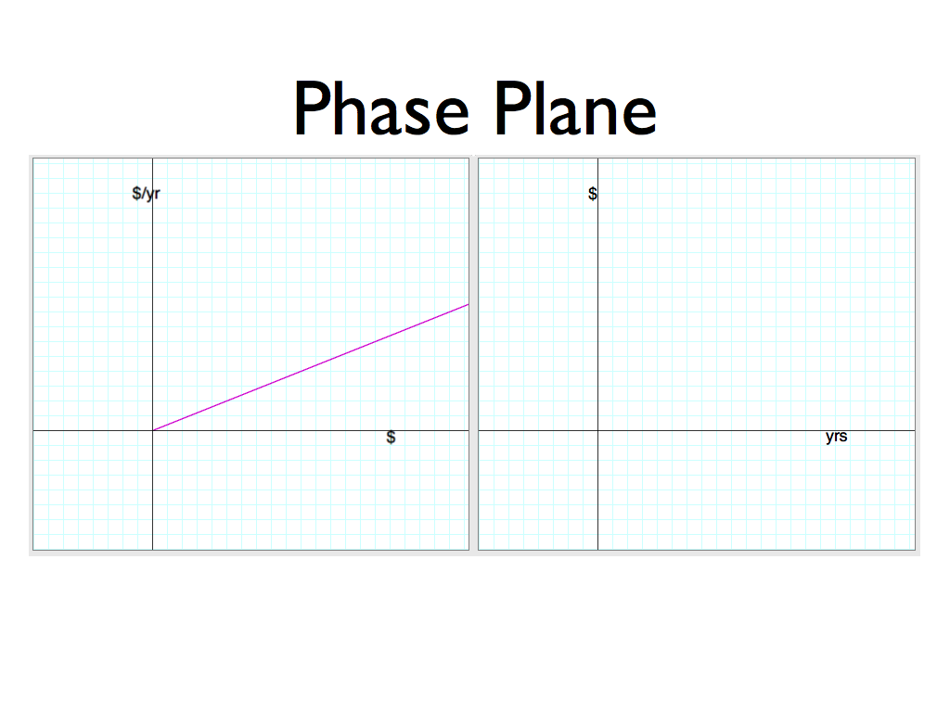
Public High School
Algebra II
Second Semester (March)
Two top students

Slide 11
See also: Castillo-Garsow, 2010

Slide 12
See also: Castillo-Garsow, 2010

Slide 13
Continuous Reasoning in the Classroom
Students are very good at transferring discrete methods to ‘continuous’ problems (Bassok & Olseth, 1995)

Slide 14
Continuous Reasoning in the Classroom
Students are not so good at transferring continuous methods to ‘discrete’ problems (Bassok & Olseth, 1995)

Slide 15
How do we teach continuous reasoning?

Slide 16
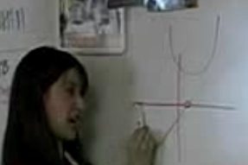
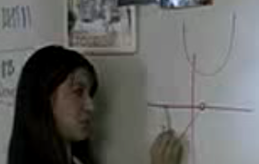
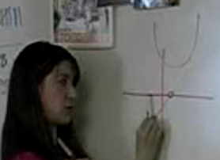
How do we teach continuous reasoning?
We live, move, and teach in a continuous world
Continuity comes naturally when we think with our body

Slide 17
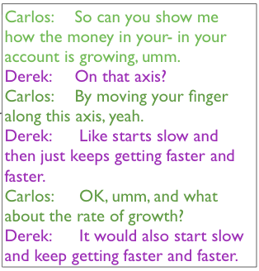
How do we teach continuous reasoning?
We live, move, and teach in a continuous world
Continuity comes naturally when we think with our body
The body plays a role in teaching continuity to students

Slide 18

We have the technology
Animation provides continuity in time
Touch provides continuity in space

Slide 19
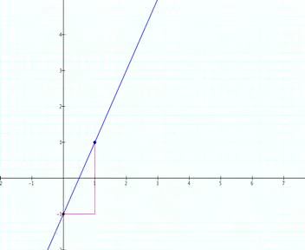

Slide 20
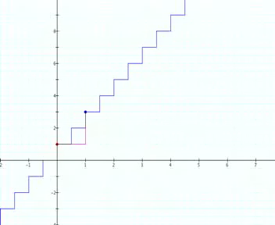

Slide 21
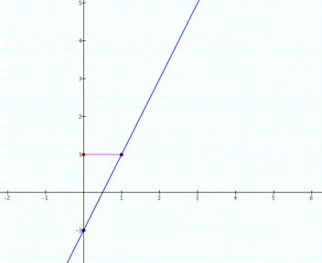

Slide 22
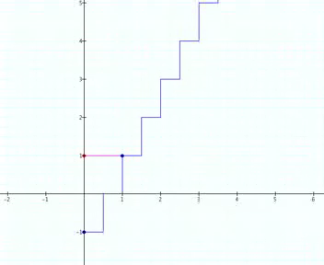

Slide 23
Thank you
Carlos Castillo-Garsow
Kansas State University
cwcg@k-state.edu

